Slide 1
Birds classification implement by DenseNet
SUN Zhen，LIN Di，GUO Peiyuan

Slide 2
CONTENTS
1 Background
2 Implementation
3 Summarize

Slide 3
PART 1
Background

Slide 4


Review of Problem
Problem Description:
use Convolutional Neural Network to predict the species of each bird.
DataSets Description:
1. Number of categories: 200
2. Number of images: 11,788
3. disadvantage：very few pictures of each categories of bird

Slide 5
Survey of Problem
Some common convolutional neural networks:
LeNet
AlexNet
VGG Net
GooogleNet
EfficientNet
InceptionNet（Most widely used）
ResNet（Most widely used）
DenseNet

Slide 6
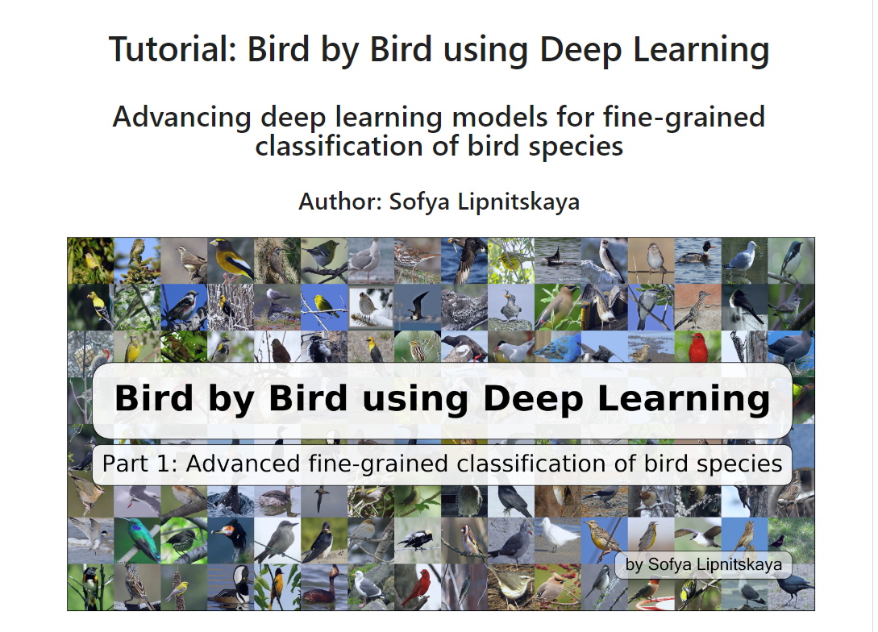
Related Work
In this article, the author used ResNet-50 model and finally achieved 82.4% accuracy.
We know that overfitting is easy in small datasets, and since DenseNet uses a denser connection method than ResNet, we suspect that using DenseNet may perform better when classifying birds in this dataset.
https://github.com/slipnitskaya/caltech-birds-advanced-classification/blob/master/notebook.ipynb

Slide 7
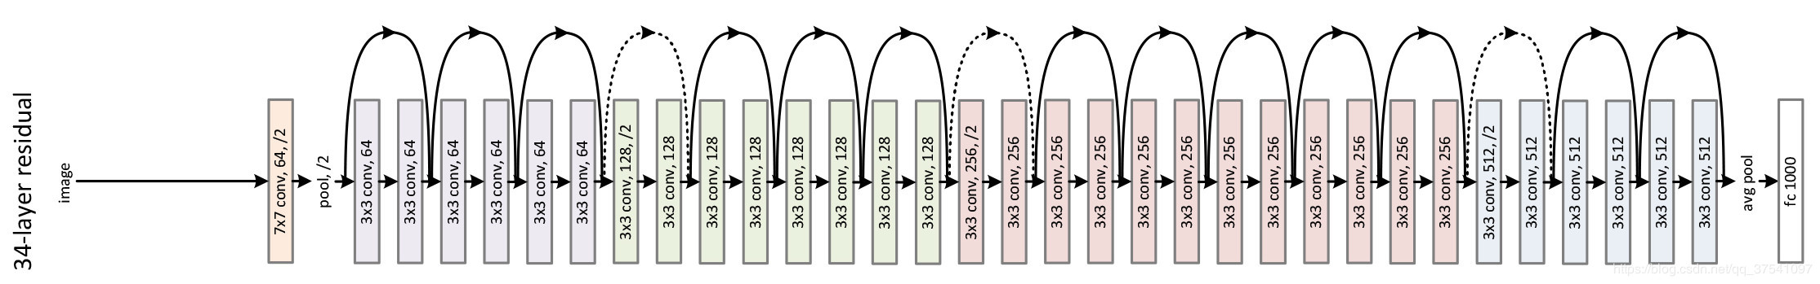

Brief Introduction of DenseNet
Compared to traditional convolutional feed-forward, ResNet add a skip-connection that the gradient can flow directly from later layers to the earlier layers.
ResNet-34 Model

Slide 8
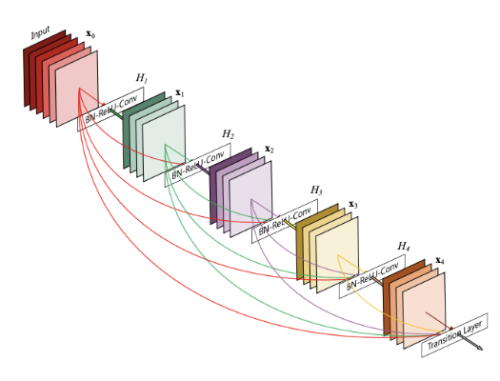
Brief Introduction of DenseNet
However, the gradient flow may be impeded because the output is combined by summation. To further improve the information flow between layers, DenseNet direct connections from any layer to all subsequent layers, the layer receives the feature-maps of all preceding layers as input.

Slide 9
PART 2
Implementation

Slide 10
Ⅰ Build DenseNet121 model with PyTorch
Ⅳ
Add
SENet
Framework：PyTorch is an open-source machine learning framework for production deployment, the framework supports DenseNet
Data preparation：
calculate the number of birds species and how many pictures in each birds species, change the birds species name to numeric values, disorder pictures
divide dataset to training and testing dataset at the ratio of 9:1
Some action to transform pictures，including
Padding training images
Random Crop
Horizontal Flip
Vertical Flip
Ⅴ
Add Picture
Rotation
Ⅲ
Better
Structure
Ⅱ
Pretrained
Model
Ⅰ
DenseNet
121

Slide 11
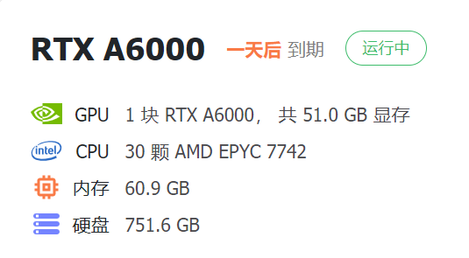
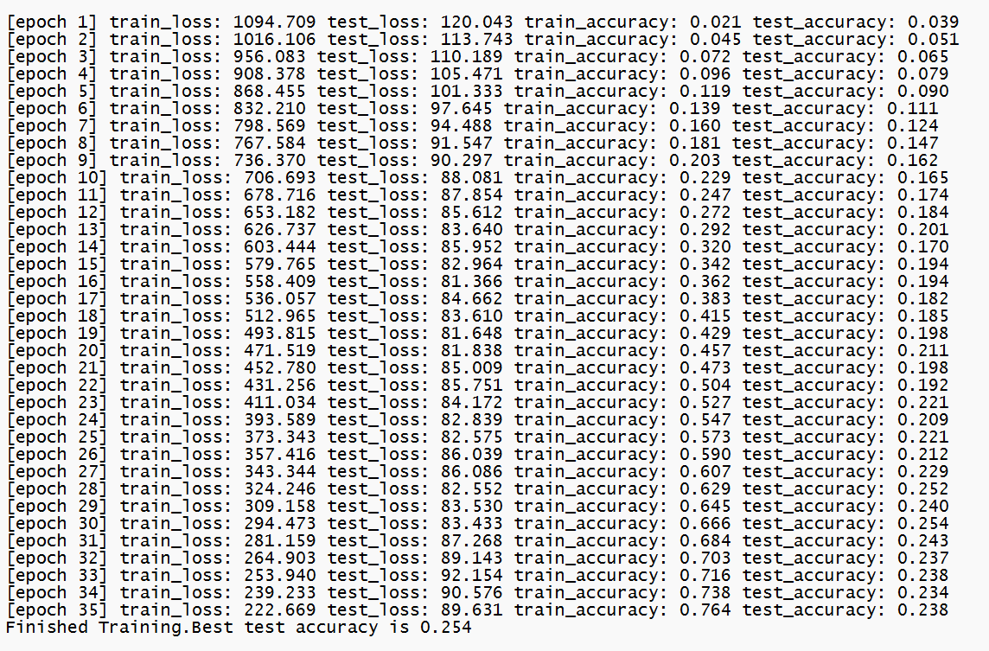
Ⅰ Build DenseNet121 model with PyTorch
Ⅳ
Add
SENet
Environment：We rented a machine learning server.
Result：As the figure shows, we find the best testing accuracy in 35 rounds is only 0.254, which is a bad performance.
Ⅴ
Add Picture
Rotation
Ⅲ
Better
Structure
Ⅱ
Pretrained
Model
Ⅰ
DenseNet
121

Slide 12
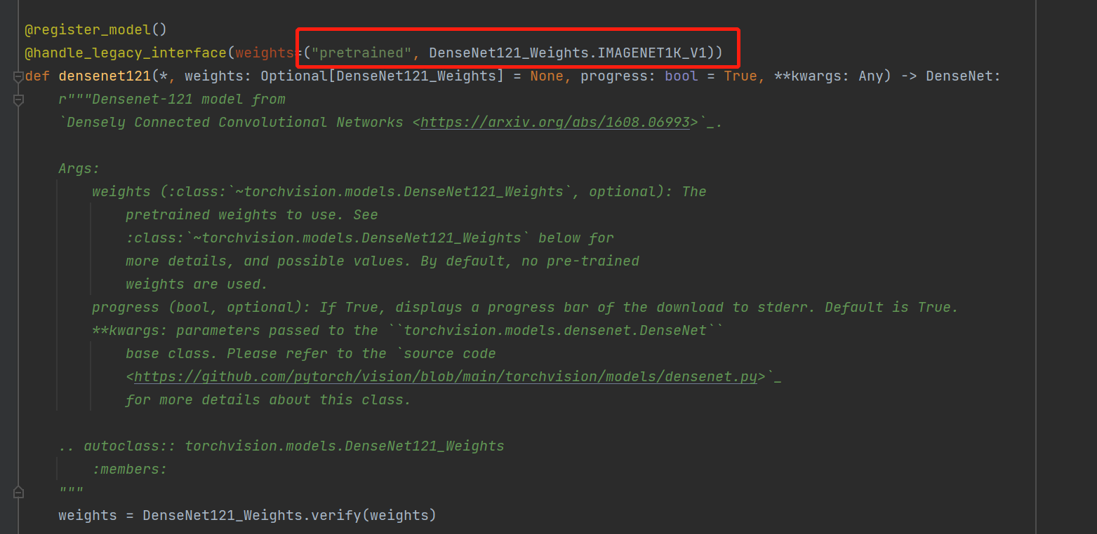
Ⅱ Pre-training DenseNet model on ImageNet
Ⅳ
Add
SENet
Brief Introduction ：We use the ImageNet pre-training model for transfer learning. There are two reasons:
ImageNet is a data set with a lot of pre-marked training data in the image field. The larger the quantity, the more reliable the training parameters.
ImageNet has 1000 classes and many categories, it is a general image data, which has little to do with the field, so it has good universality.
Implement: After looking up PyTorch DenseNet source code, we find that all four DenseNet structures in PyTorch have already support pre-training. we can directly change our program code to rebuild our densenet121 model by setting the pre-training argument.
Ⅲ
Better
Structure
Ⅴ
Add Picture
Rotation
Ⅰ
DenseNet
121
Ⅱ
Pretrained
Model

Slide 13
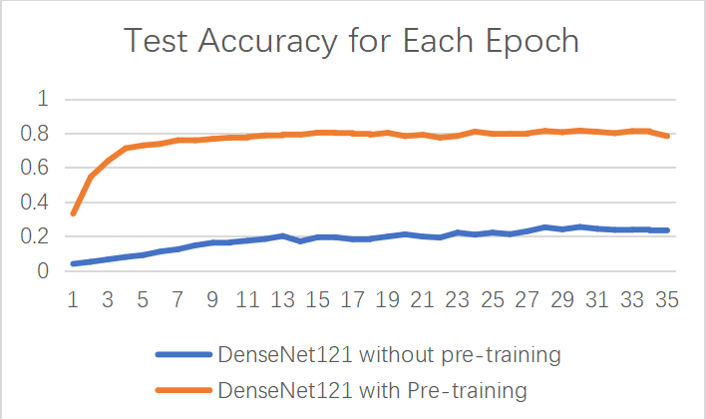
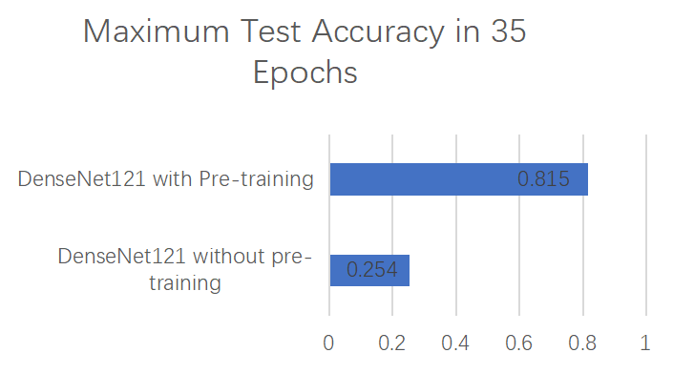
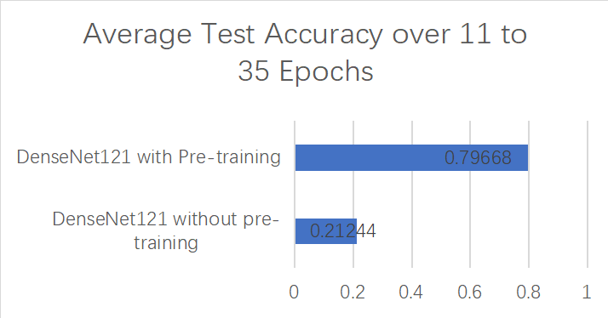
Ⅱ Pre-training DenseNet model on ImageNet
Ⅳ
Add
SENet
Result and Comparison：
Ⅲ
Better
Structure
Ⅴ
Add Picture
Rotation
Ⅰ
DenseNet
121
Ⅱ
Pretrained
Model

Slide 14
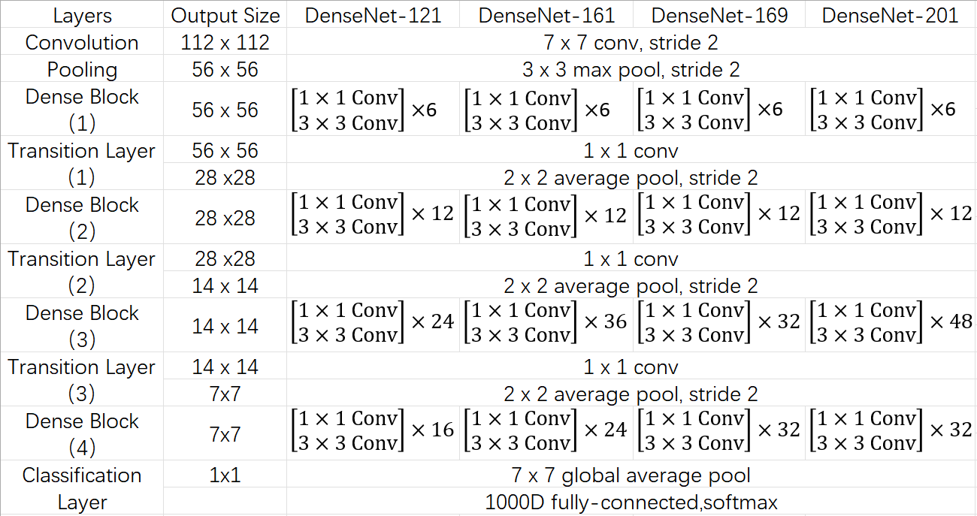
Ⅲ Choose Better Structure
Ⅳ
Add
SENet
Brief introduction of four DenseNet Struct：PyTorch support four DenseNet structures for users to choose. The main differences between four structures are the number of Dense layers in each Dense Block.
Ⅴ
Add Picture
Rotation
Ⅲ
Better
Structure
Ⅰ
DenseNet
121
Ⅱ
Pretrained
Model

Slide 15
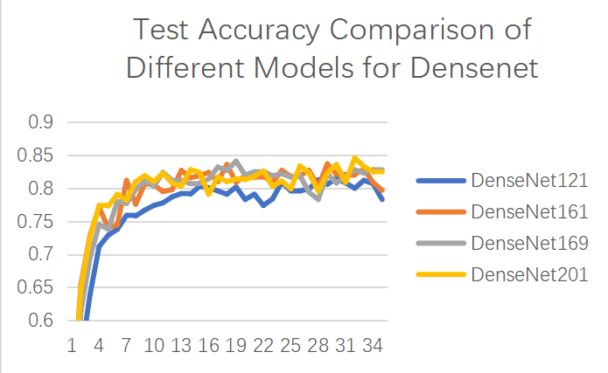
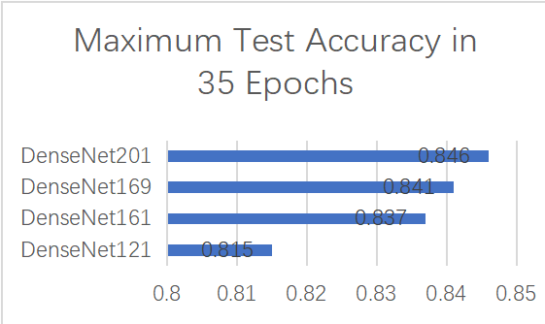
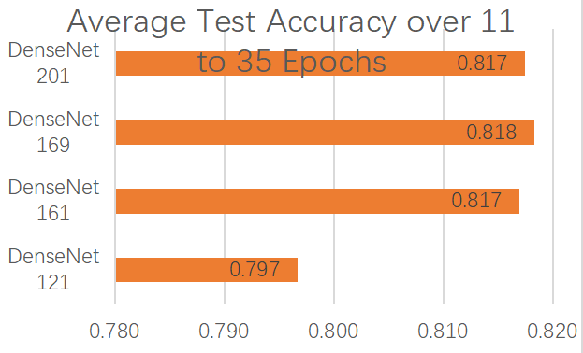
Ⅲ Choose Better Structure
Ⅳ
Add
SENet
Performance Comparison:
Ⅴ
Add Picture
Rotation
Ⅲ
Better
Structure
Ⅰ
DenseNet
121
Ⅱ
Pretrained
Model
Notes:
Comparing the Maximum Test Accuracy and Average Test accuracy of those four DenseNet structures, we find that densenet201 has the best performance on our birds classification prediction.

Slide 16
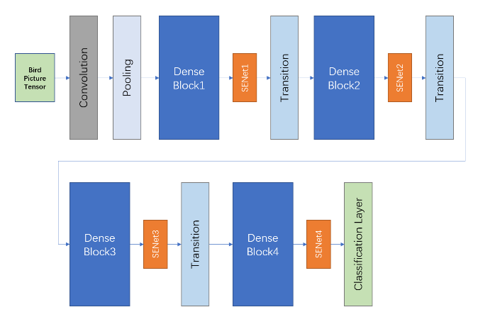
Ⅳ Add Squeeze-and-Excitation (SE) Networks
Ⅳ
Add
SENet
Brief introduction: Squeeze-and-Excitation (SE) Networks is widely used for performing feature recalibration, which is also named channel attention
Modify DenseNet structure by adding SE Block:
Ⅴ
Add Picture
Rotation
Ⅲ
Better
Structure
Ⅰ
DenseNet
121
Ⅱ
Pretrained
Model
Notes:
We suspect that adding the channel attention to the DenseNet structure will improve the prediction accuracy.
We try to add SE Networks after each dense block

Slide 17
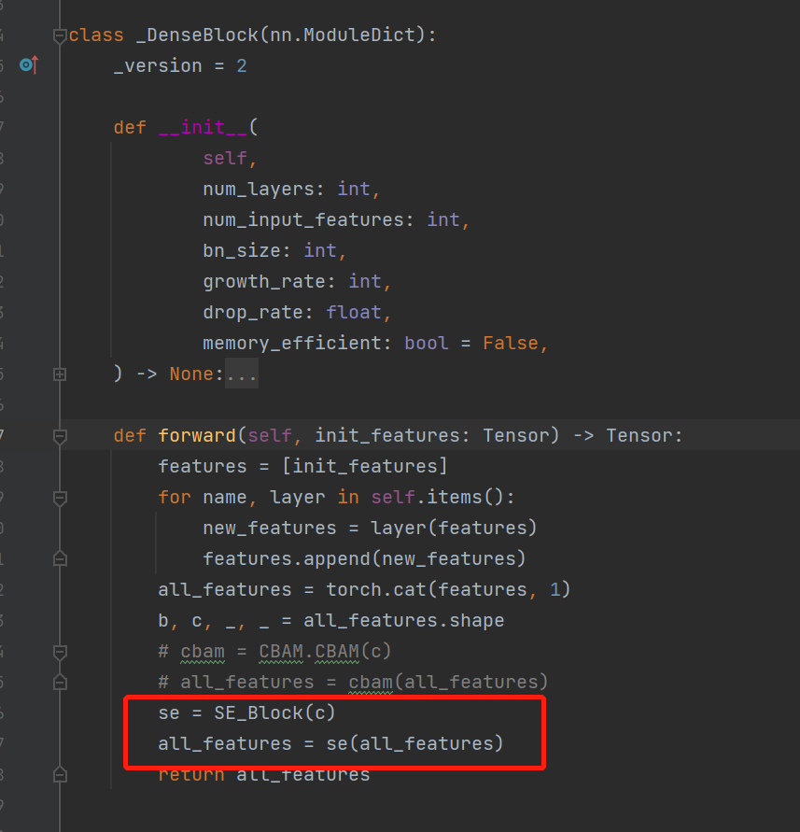
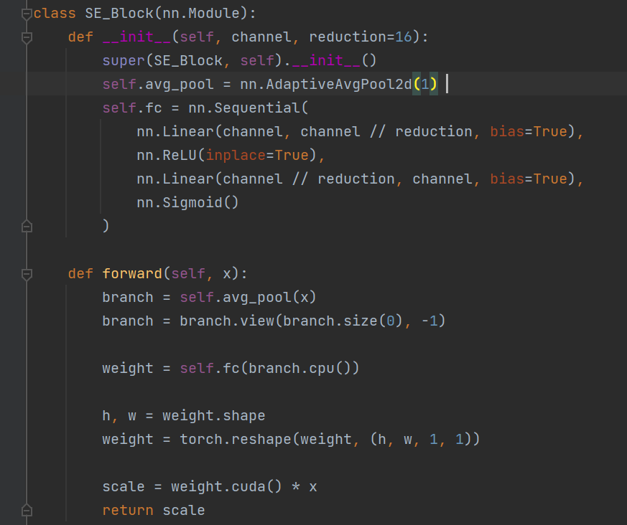
Ⅳ Add Squeeze-and-Excitation (SE) Networks
Ⅳ
Add
SENet
Implement: We modified the source code of the _DenseBlock library function in pytorch to add an SE Block.
Ⅴ
Add Picture
Rotation
Ⅲ
Better
Structure
Ⅰ
DenseNet
121
Ⅱ
Pretrained
Model
Notes:
We suspect that adding the channel attention to the DenseNet structure will improve the prediction accuracy.
We try to add SE Networks after each dense block

Slide 18
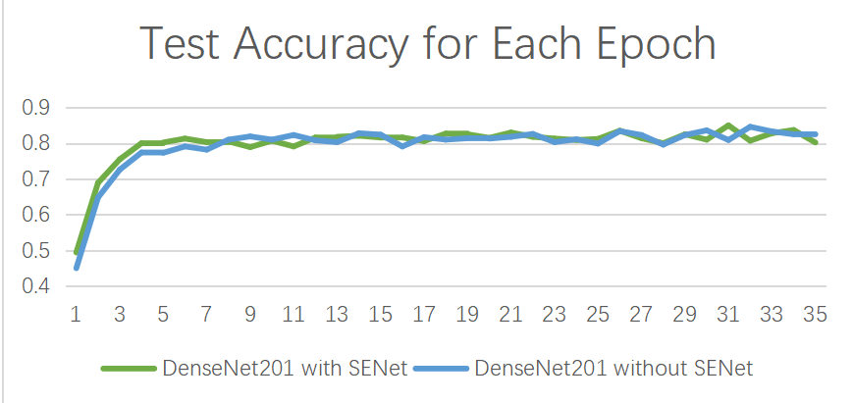
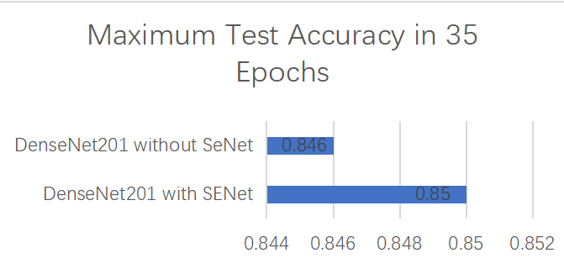
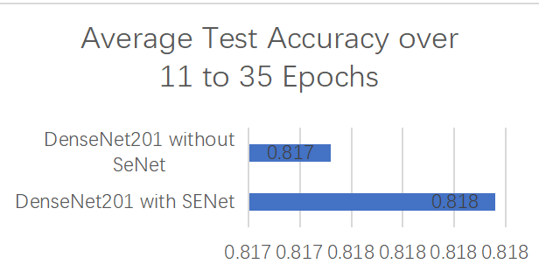
Ⅳ Add Squeeze-and-Excitation (SE) Networks
Ⅳ
Add
SENet
Performance Comparison:
Ⅴ
Add Picture
Rotation
Ⅲ
Better
Structure
Ⅰ
DenseNet
121
Ⅱ
Pretrained
Model
Notes:
As figures show, after adding SE blocks, the Maximum Test Accuracy and the Average Test Accuracy improve a little bit.

Slide 19
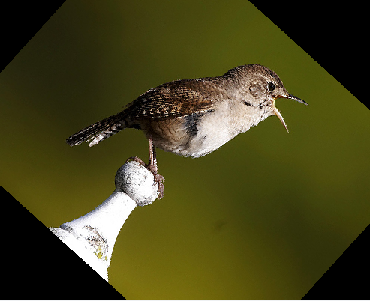
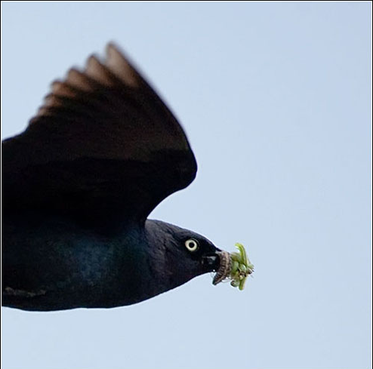
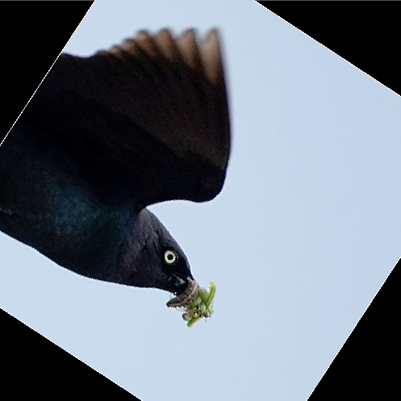
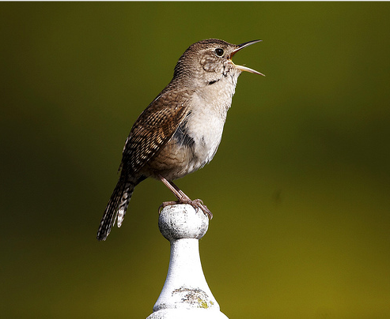
Ⅴ Add Picture Rotation
Ⅳ
Add
SENet
Brief introduction: we try some extra operations such as random rotation on training birds pictures, to enlarge training dataset, hoping there are more useful features which can improve the performance of densenet201 model (with SE blocks). At last，We decide to random rotate training images within a range [-45, 45].
Ⅴ
Add Picture
Rotation
Ⅲ
Better
Structure
Ⅱ
Pretrained
Model
Ⅰ
DenseNet
121

Slide 20
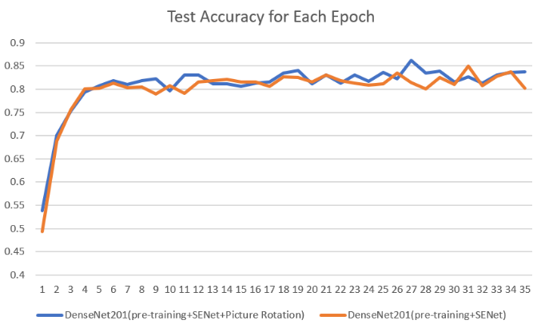
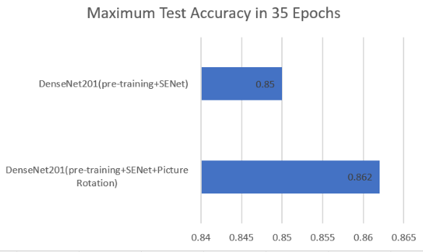
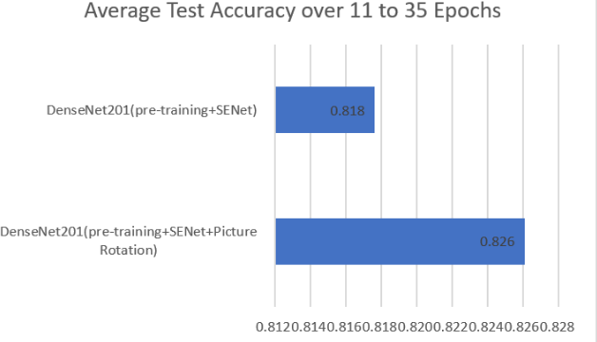
Ⅴ Add Picture Rotation
Ⅳ
Add
SENet
Performance Comparison:
Ⅴ
Add Picture
Rotation
Ⅲ
Better
Structure
Ⅱ
Pretrained
Model
Ⅰ
DenseNet
121

Slide 21
PART 3
Summarize

Slide 22
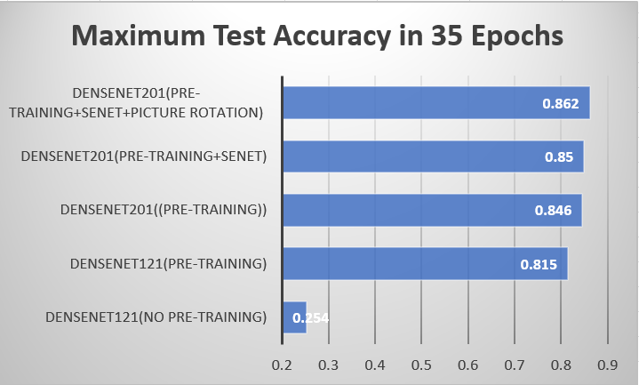
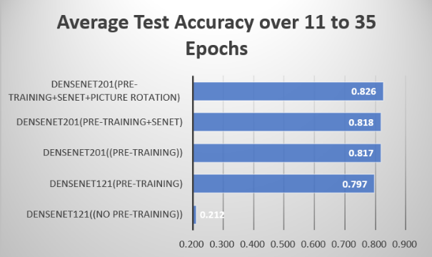
Summarize
We implement our birds classification model using Dense Convolutional Network (DenseNet) in PyTorch Framework, find four ways to improve test accuracy of our model.

Slide 23
Thanks for listening!
Q&A

